Slide 1
Linear Convolution

Slide 10
Circular Convolution

Slide 20
Computation of Circular Convolution using Linear Convolution

Slide 22
Computation of linear Convolution using Circular Convolution

Slide 38
2D Convolution

Slide 39
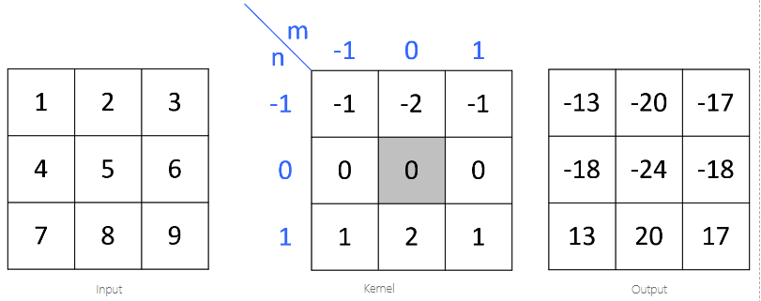

Slide 40
Notice that the origin of impulse response is always centered. (h[0,0] is located at the center sample of kernel, not the first element.)
Let's start calculate each sample of the output one by one. First, flip the kernel, which is the shaded box, in both horizontal and vertical direction. Then, move it over the input array. If the kernel is centered (aligned) exactly at the sample that we are interested in, multiply the kernel data by the overlapped input data. The accumulation (adding these 9 multiplications) is the last thing to do to find out the output value. Note that the matrices are referenced here as [column, row], not [row, column]. M is horizontal (column) direction and N is vertical (row) direction.

Slide 48
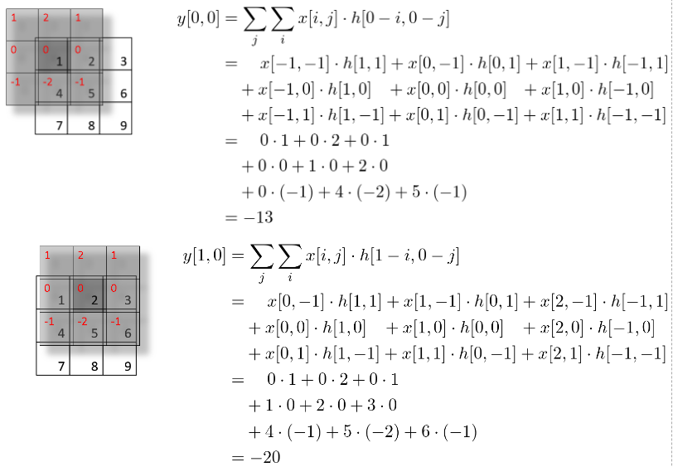

Slide 49
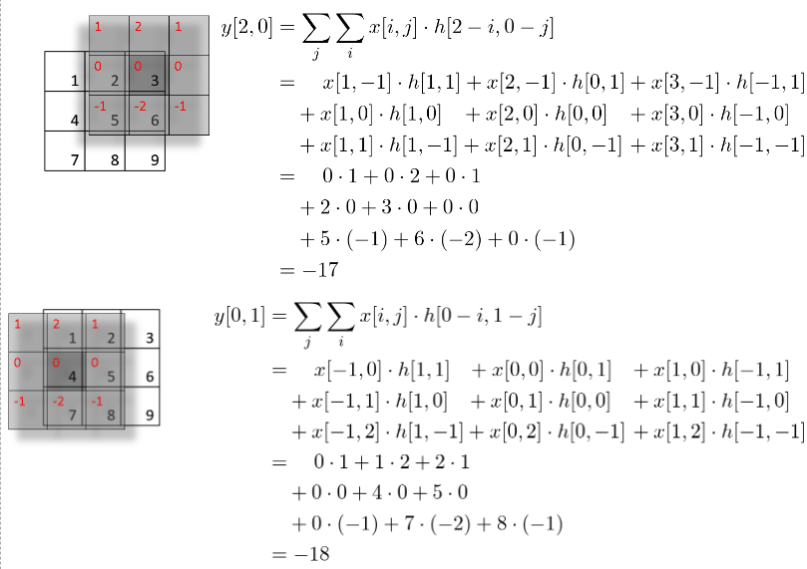

Slide 50
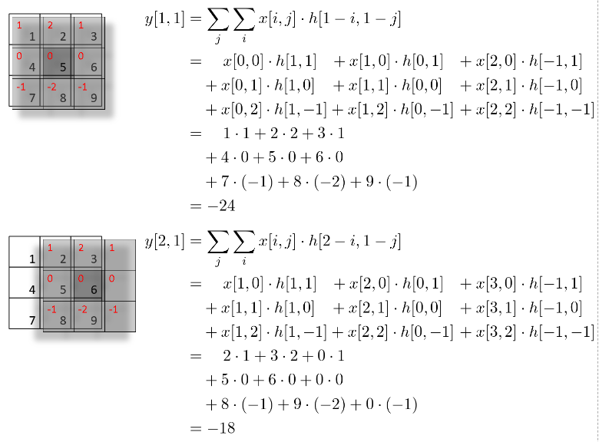

Slide 51
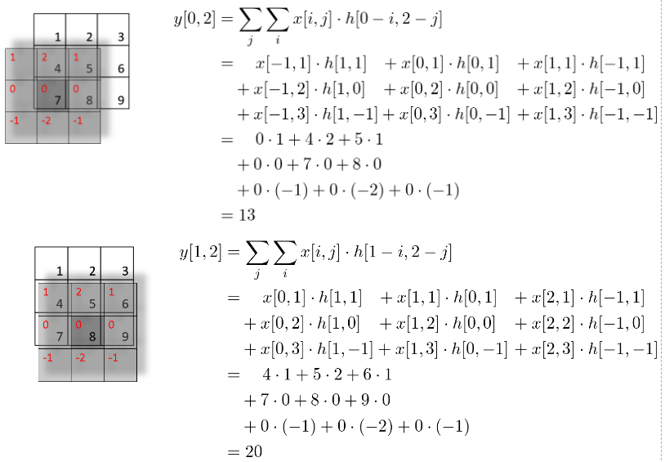

Slide 52
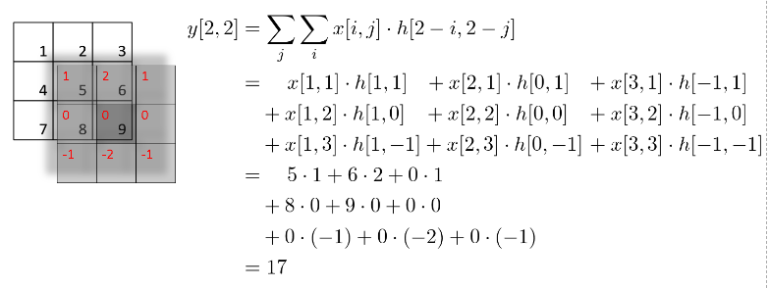

Slide 53
gray level operations images.

Slide 54
Operations
Read Digital Image
Convert color image to grayscale image
Image Negation
Image Thresholding
Image Gamma Correction

Slide 55
Gray Scale image
Grayscale images are particularly useful when the color information is not relevant to the analysis or when the goal is to simplify the image data for computational purposes. They are a fundamental concept in image processing and computer vision.
A grayscale image, often referred to as a black-and-white image, is an image in which each pixel is represented by a single intensity value, typically ranging from 0 (black) to 255 (white) in an 8-bit image. In a grayscale image, there is no color information; instead, it represents only the brightness or luminance of each pixel.
The grayscale value at each pixel represents the intensity or brightness of that pixel. Higher values indicate brighter areas, while lower values indicate darker areas.

Slide 56
Applications:
Grayscale images are commonly used in various fields, including medical imaging (such as X-rays and MRI scans), computer vision, image processing, and document scanning. They are also used for artistic purposes in black-and-white photography.
Grayscale images require less storage space compared to color images because they have only one channel instead of three. This can be advantageous in applications where storage capacity is limited.

Slide 57
Image Negation
Image negation is a simple operation that creates the negative or inverse of an image. In a grayscale image, each pixel's intensity value is subtracted from the maximum intensity value (typically 255 for 8-bit grayscale images). The result is that lighter areas become darker, and darker areas become lighter. This operation is used to create a photographic negative effect.
For example, if you have a pixel with an intensity of 100 in the original image, its intensity in the negated image will be 155 (255 - 100). This operation can be expressed as:

Slide 58
Negated_pixel_value = Maximum_intensity_value - Original_pixel_value
Negated_pixel_value = 255 - Original_pixel_value

Slide 59
Image thresholding
Image thresholding is a technique used to segment an image into binary regions, where pixels are classified as either foreground (object of interest) or background based on a specified threshold value. Pixels with intensity values greater than or equal to the threshold are set to a maximum value (usually 255 for white), while pixels with intensity values less than the threshold are set to a minimum value (usually 0 for black).
if pixel_value >= threshold:
thresholded_pixel_value = 255 # Foreground
else:
thresholded_pixel_value = 0 # Background

Slide 60
Image Gamma Correction
Image gamma correction is a non-linear operation used to adjust the brightness and contrast of an image. It involves raising the pixel values to a specific exponent (gamma value) to modify the overall appearance of the image. It's particularly useful for correcting images that appear too dark or too bright.
The gamma correction formula is as follows:
Corrected_pixel_value = Original_pixel_value ^ (1 / gamma)
If gamma is less than 1, it enhances the contrast and brightens the image.
If gamma is greater than 1, it reduces the contrast and darkens the image.
If gamma is equal to 1, there is no change to the image.
By adjusting the gamma value, you can control the overall brightness and contrast of the image to achieve the desired visual effect.

Slide 61
Point Wise Intensity Transformation or Gray Level Transformation

Slide 63
Negative Transformation

Slide 64
Log Transform

Slide 65
Power Law Transformation

Slide 66
Gamma Correction

Slide 67
Contrast Stratching

Slide 68
Dynamic Range Expension

Slide 69
Intensity Level Slicing

Slide 70
Intensity Level Slicing

Slide 71
Bit Plane Slicing

Slide 72
Bit plane slicing

Slide 73
Histogram
A histogram of an image is a graphical representation of the distribution of pixel intensity values in that image. It provides information about the brightness or color distribution in the image. The x-axis of the histogram represents the range of pixel intensity values, while the y-axis represents the frequency or count of pixels at each intensity level.
In grayscale images, the intensity values typically range from 0 (black) to 255 (white). For color images, you have separate histograms for each color channel (Red, Green, Blue).

Slide 74
key points about histograms of images
Histograms are useful for various image processing tasks, including adjusting brightness and contrast, enhancing images, and performing operations like histogram equalization and matching, as mentioned in previous responses.

Slide 75
Image Histogram

Slide 76
Contrast Stratching

Slide 77
Histogram Equalization
Histogram equalization is a technique used in image processing to improve the contrast and enhance the details in an image by redistributing the intensity values in its histogram. It's particularly useful when an image has poor contrast, making it look washed out or difficult to interpret. Histogram equalization aims to stretch the range of intensity values in the image to cover the entire available range, thereby improving the overall visual quality.

Slide 78
Histogram Equalization

Slide 79
Steps
Compute the Histogram: The first step is to calculate the histogram of the input image. This histogram represents the distribution of pixel intensity values, typically ranging from 0 (black) to 255 (white) for grayscale images.
Calculate the Cumulative Distribution Function (CDF): Next, you calculate the cumulative distribution function of the histogram. The CDF represents the cumulative sum of frequencies in the histogram and shows how many pixels have intensity values less than or equal to a given value.
Normalize the CDF: To ensure that the full range of intensities is used, you normalize the CDF. This involves scaling the CDF values to the full range, typically from 0 to 255 in the case of an 8-bit grayscale image.
Map Intensity Values: Finally, you map the intensity values of the original image using the normalized CDF. Each pixel's intensity value in the original image is replaced with the corresponding value from the normalized CDF.

Slide 80
The result is an equalized image with improved contrast. Dark areas become darker, bright areas become brighter, and the overall distribution of intensities is spread out more evenly across the available range. This process enhances the visual details in the image and can make it more visually appealing.
Histogram equalization is a useful tool in image processing, but it may not always be suitable for all images. In some cases, it can lead to artifacts or unrealistic enhancements, especially when the original image already has a good contrast. However, it is a valuable tool in situations where image contrast needs improvement, such as in medical imaging, satellite imagery, and enhancing old photographs.

Slide 81
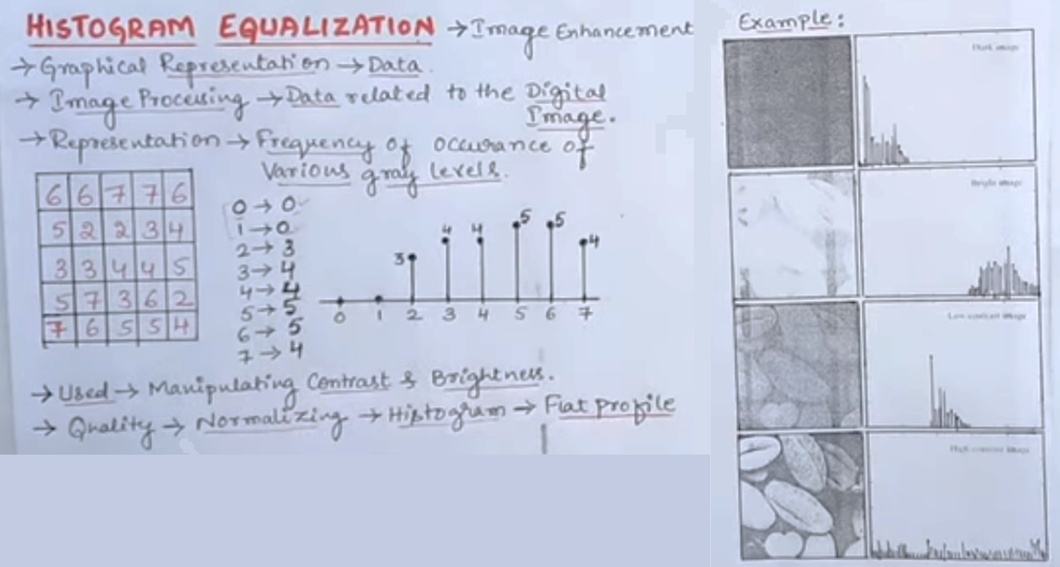

Slide 82
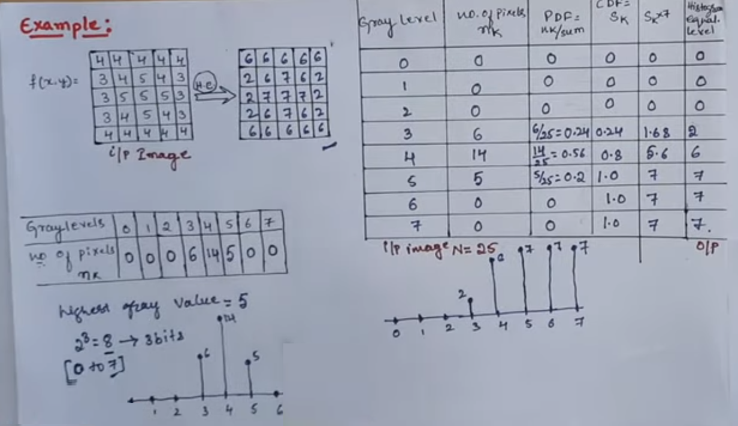

Slide 83
Histogram Matching
Histogram matching, also known as histogram specification or histogram equalization with a reference image, is a technique in image processing that aims to adjust the histogram of one image (the source image) to match the histogram of another image (the reference image). This process allows you to transfer the tonal characteristics and contrast of the reference image to the source image. Histogram matching is often used to achieve a desired look or to bring the characteristics of one image into another.

Slide 84
Steps in Histogram Matching
Compute histograms for each image
Take the reference image histogram
Update the pixel intensity values in the input image using the reference histogram, such that they match

Slide 85
The result is a new image (the matched image) with a histogram that closely resembles the histogram of the reference image. This process can be used to align the tonal characteristics and contrast of the source image with those of the reference image. The matched image will have a similar overall tonal distribution, which can be particularly useful for tasks such as style transfer or color correction.
Histogram matching is a powerful tool in image processing, and it can be employed in various applications, including medical image analysis, color grading in photography and film, and improving the consistency of images in computer vision tasks.

Slide 86
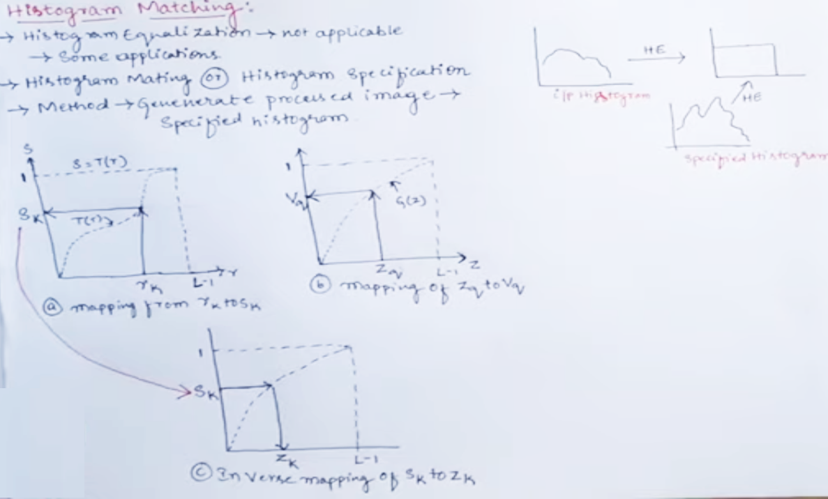

Slide 87
Filtering in Spatial domain
refers to image operators that change the gray value at any pixel (x,y) depending on the pixel values in a square neighborhood centered at (x,y) using a fixed integer matrix of the same size. The integer matrix is called a filter , mask, kernel or a window.
The mechanism of spatial filtering, shown below, consists simply of moving the filter mask from pixel to pixel in an image. At each pixel (x,y), the response of the filter at that pixel is calculated using a predefined relationship (linear or nonlinear).

Slide 88
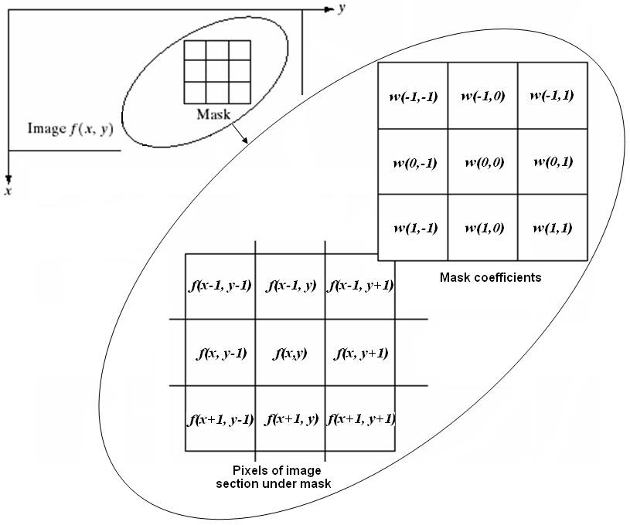
The size of mask must be odd (i.e. 3×3, 5×5, etc.) to ensure it has a center. The smallest meaningful size is 3×3.

Slide 89
Linear Spatial Filtering (Convolution)
The process consists of moving the filter mask from pixel to pixel in an image. At each pixel (x,y), the response is given by a sum of products of the filter coefficients and the corresponding image pixels in the area spanned by the filter mask.
For the 3×3 mask shown in the previous figure, the result (or response), R, of linear filtering is:
𝑅 = w(−1, −1)ƒ(𝑥 − 1, 𝑦 − 1) + w(−1,0)ƒ(𝑥 − 1, 𝑦) + ⋯
+w(0,0)ƒ(𝑥, 𝑦) + ⋯ + w(1,0)ƒ(𝑥 + 1, 𝑦) + w(1,1)ƒ(𝑥 + 1, 𝑦 + 1)

Slide 90
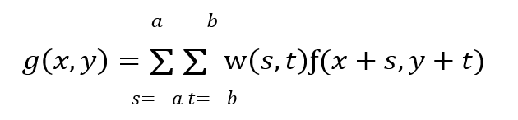
In general, linear filtering of an image f of size M×N with a filter mask of size m×n is given by the expression:
where a = (m - 1)/2 and b = (n - l)/2. To generate a complete filtered image this equation must be applied for x = 0,1, 2,..., M-1 and y = 0,1, 2,..., N-1.

Slide 91
Nonlinear Spatial Filtering
The operation also consists of moving the filter mask from pixel to pixel in an image. The filtering operation is based conditionally on the values of the pixels in the neighborhood, and they do not explicitly use coefficients in the sum-of-products manner.
For example, noise reduction can be achieved effectively with a nonlinear filter whose basic function is to compute the median gray-level value in the neighborhood in which the filter is located. Computation of the median is a nonlinear operation.

Slide 92
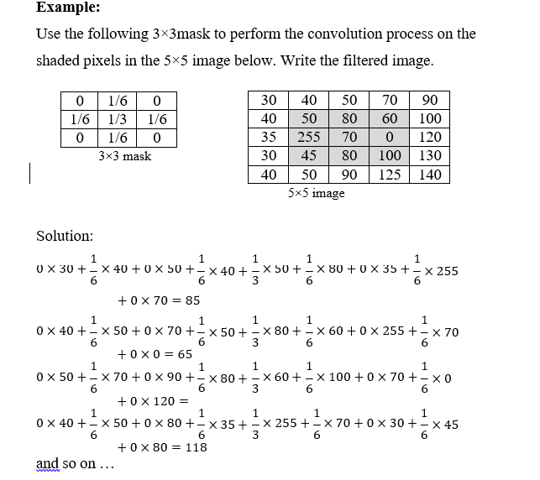
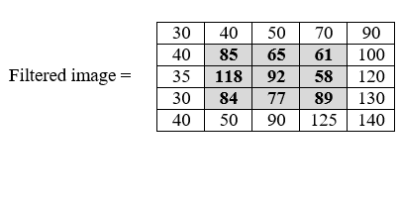

Slide 93
Spatial Filters
Spatial filters can be classified by effect into:
Smoothing Spatial Filters: also called lowpass filters. They include:
Averaging linear filters
Order-statistics nonlinear filters.
Sharpening Spatial Filters: also called highpass filters. For example, the Laplacian linear filter.

Slide 94
Smoothing Spatial Filters
are used for blurring and for noise reduction. Blurring is used in preprocessing steps to:
remove small details from an image prior to (large) object extraction
bridge small gaps in lines or curves.
Noise reduction can be accomplished by blurring with a linear filter and also by nonlinear filtering.

Slide 95
Averaging linear filters
The response of averaging filter is simply the average of the pixels contained in the neighborhood of the filter mask.
The output of averaging filters is a smoothed image with reduced "sharp" transitions in gray levels.
Noise and edges consist of sharp transitions in gray levels. Thus smoothing filters are used for noise reduction; however, they have the undesirable side effect that they blur edges.

Slide 96
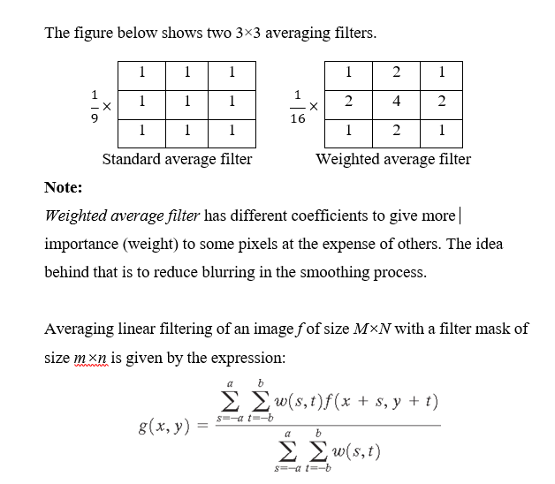

Slide 97
Effects of averaging linear filter are:
Blurring which is increased whenever the mask size increases.
Blending (removing) small objects with the background. The size of the mask establishes the relative size of the blended objects.
Black border because of padding the borders of the original image.
Reduced image quality.

Slide 98
Order-statistics filters
are nonlinear spatial filters whose response is based on ordering (ranking) the pixels contained in the neighborhood, and then replacing the value of the center pixel with the value determined by the ranking result.
Examples include Max, Min, and Median filters.

Slide 99
Median filter
It replaces the value at the center by the median pixel value in the neighborhood, (i.e. the middle element after they are sorted). Median filters are particularly useful in removing impulse noise (also known as salt-and-pepper noise). Salt = 255, pepper = 0 gray levels.
In a 3×3 neighborhood the median is the 5th largest value, in a 5×5 neighborhood the 13th largest value, and so on.
For example, suppose that a 3×3 neighborhood has gray levels (10, 20, 0, 20, 255, 20, 20, 25, 15). These values are sorted as (0,10,15,20,20,20,20,25,255), which results in a median of 20 that replaces the original pixel value 255 (salt noise).

Slide 100
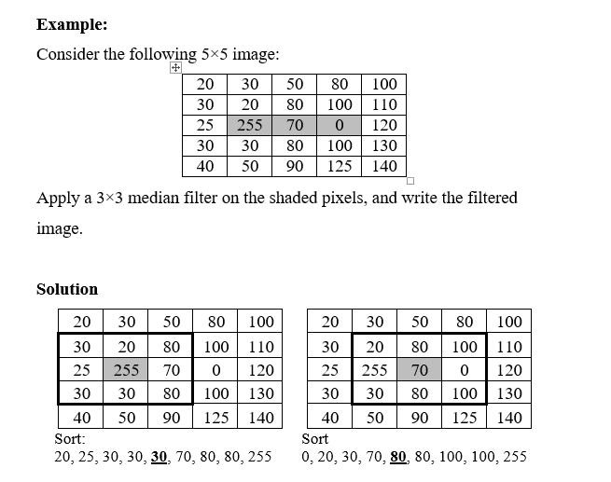

Slide 101
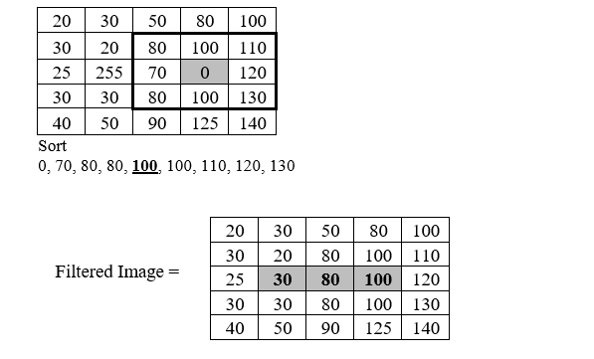

Slide 102
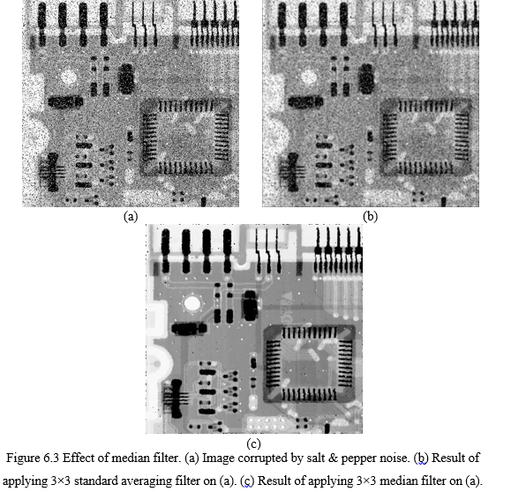

Slide 103
Sharpening Spatial Filters
Sharpening aims to highlight fine details (e.g. edges) in an image, or enhance detail that has been blurred through errors or imperfect capturing devices.
Image blurring can be achieved using averaging filters, and hence sharpening can be achieved by operators that invert averaging operators. In mathematics, averaging is equivalent to the concept of integration, and differentiation inverts integration. Thus, sharpening spatial filters can be represented by partial derivatives.

Slide 104
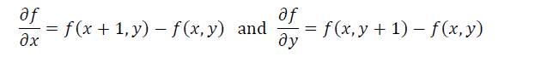
Partial derivatives of digital functions
The first order partial derivatives of the digital image f(x,y) are:
The first derivative must be:
1) zero along flat segments (i.e. constant gray values).
2) non-zero at the outset of gray level step or ramp (edges or noise)
3) non-zero along segments of continuing changes (i.e. ramps).

Slide 107
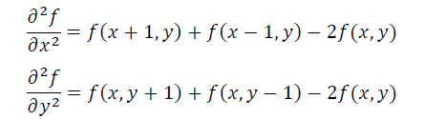
The second order partial derivatives of the digital image f(x,y) are:
The second derivative must be:
zero along flat segments.
nonzero at the outset and end of a gray-level step or ramp;
zero along ramps

Slide 110
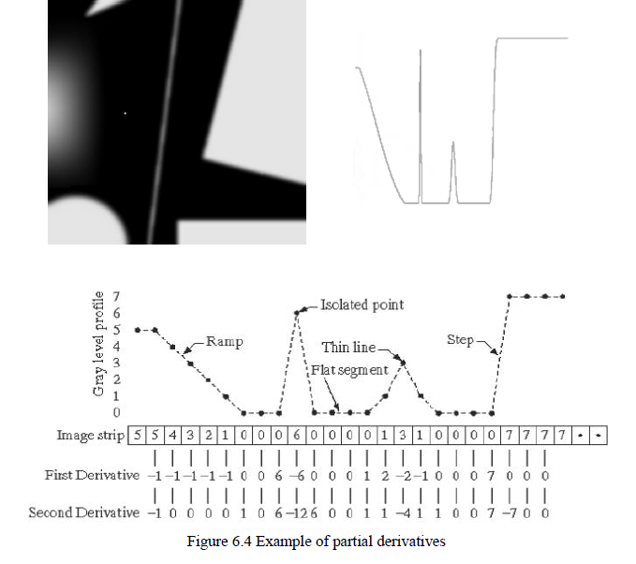

Slide 111
We conclude that:
1st derivative detects thick edges while 2nd derivative detects thin edges.
2nd derivative has much stronger response at gray-level step than 1st derivative.
Thus, we can expect a second-order derivative to enhance fine detail (thin lines, edges, including noise) much more than a first-order derivative.

Slide 112
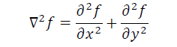
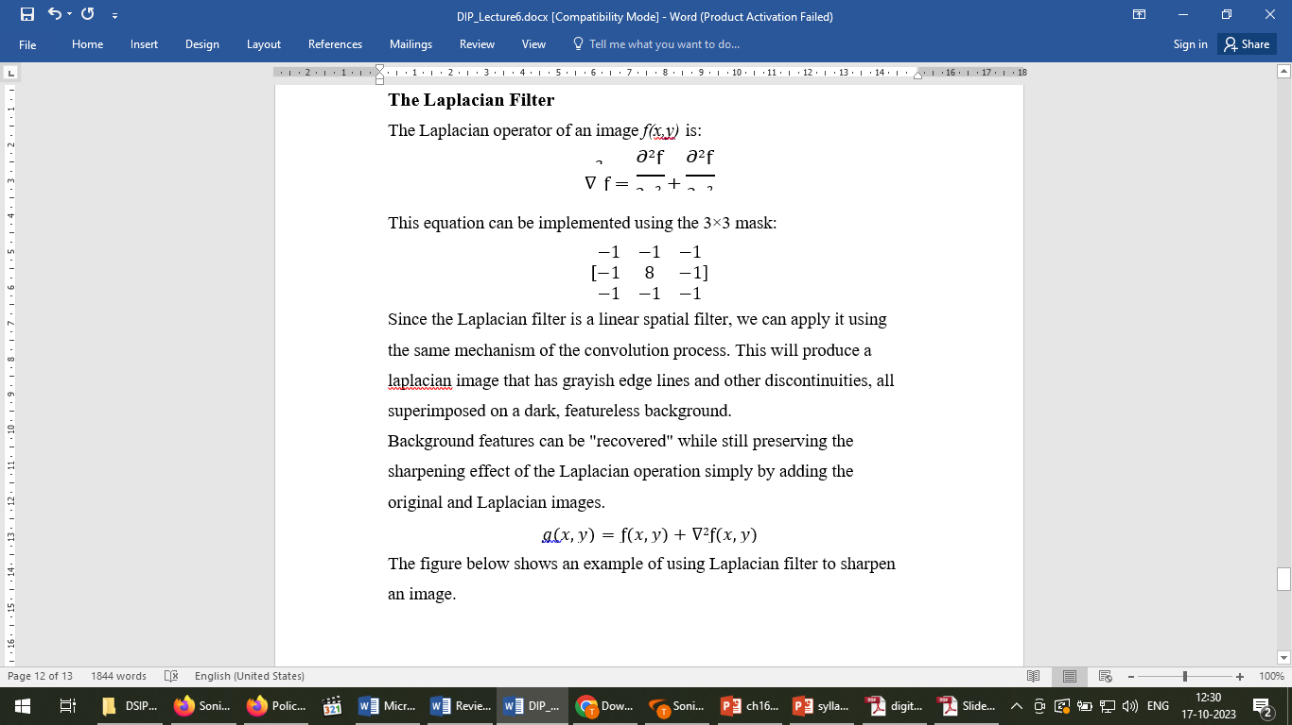
The Laplacian Filter
The Laplacian operator of an image f(x,y) is:
This equation can be implemented using the 3×3 mask:
Since the Laplacian filter is a linear spatial filter, we can apply it using the same mechanism of the convolution process. This will produce a laplacian image that has grayish edge lines and other discontinuities, all superimposed on a dark, featureless background.
Background features can be "recovered" while still preserving the sharpening effect of the Laplacian operation simply by adding the original and Laplacian images.
𝑔(𝑥, 𝑦) = ƒ(𝑥, 𝑦) + ∇²ƒ(𝑥, 𝑦)
The figure below shows an example of using Laplacian filter to sharpen an image.

Slide 113
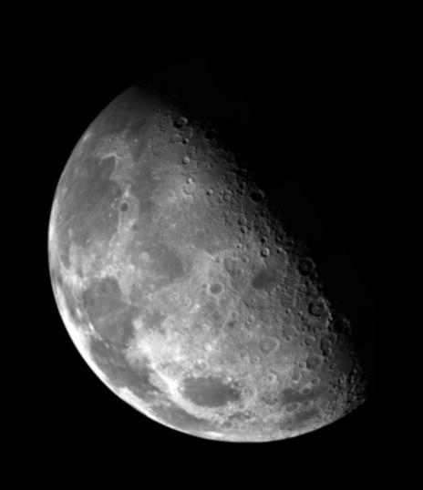
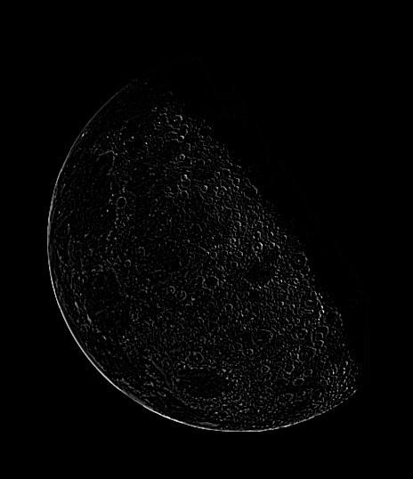

Sharpened image
Original image
Laplacian image

